Slide 1
Stimuli → Lookit Study
Create your stimuli. Export as: mp3 or mp4
Convert your stimuli to include: ogg and webm
Create an online storage platform (Using this: Lookit Tutorial)
Upload all of your stimuli to this location
Insert code into your test trials to retrieve this stimuli
Notes:
Slides by Nicole Cuneo – please credit if reusing portions!

Slide 2
Stimuli → Lookit Study
Create your stimuli. Export as: mp3 or mp4
Tips:
-White background!! Unless this impairs the study it’s useful to have a white background so you can control *some* level of the light on the participant’s face
IMPORTANT: “When you design an online study, you may need to record many of the things you’d say in the lab, or create pictures or demos to show how things work. This includes not just storybook audio, but little clips like “We’re almost done!” or “Okay, go ahead and turn around now.”” (from Lookit Tutorial)
-Recommendation: Audacity (clear, crisp, etc…)

Slide 3
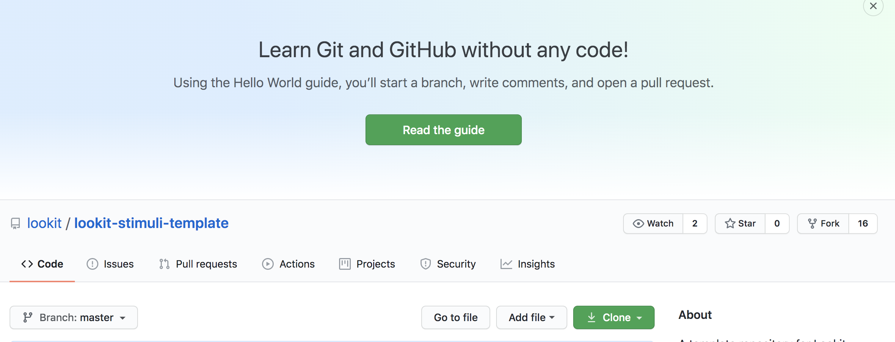
Stimuli → Lookit Study
Create your stimuli. Export as: mp3 or mp4
Convert your stimuli to include: ogg and webm
Create an online storage platform (Using this: Lookit Tutorial)
https://github.com/lookit/lookit-stimuli-template

Slide 4
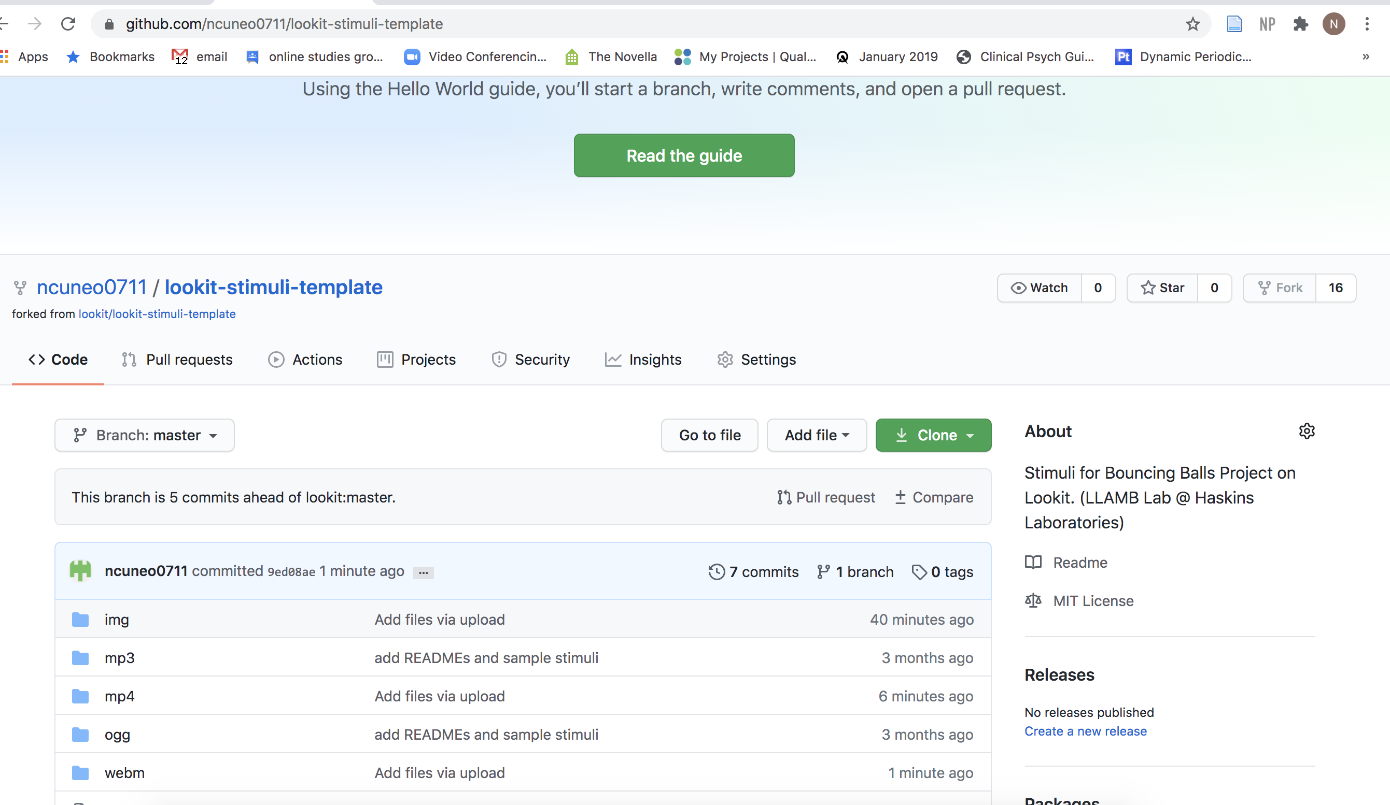
How you know you did it right:

Slide 6
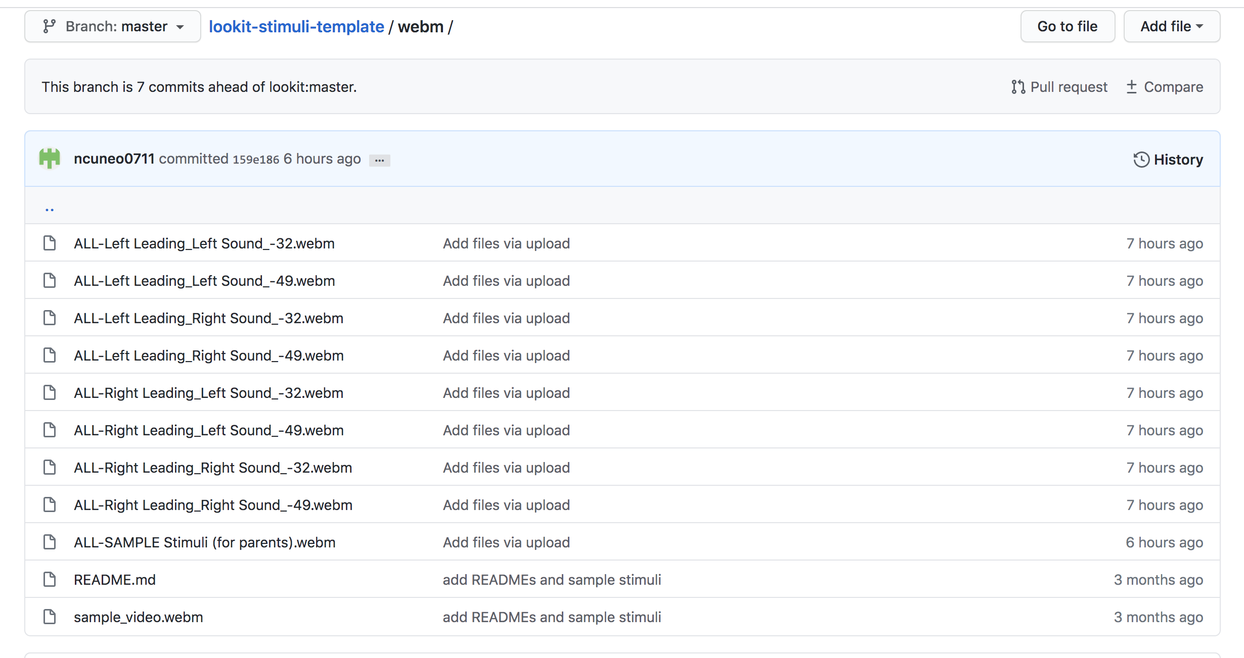
Open the folder → add your stimuli!

Slide 7
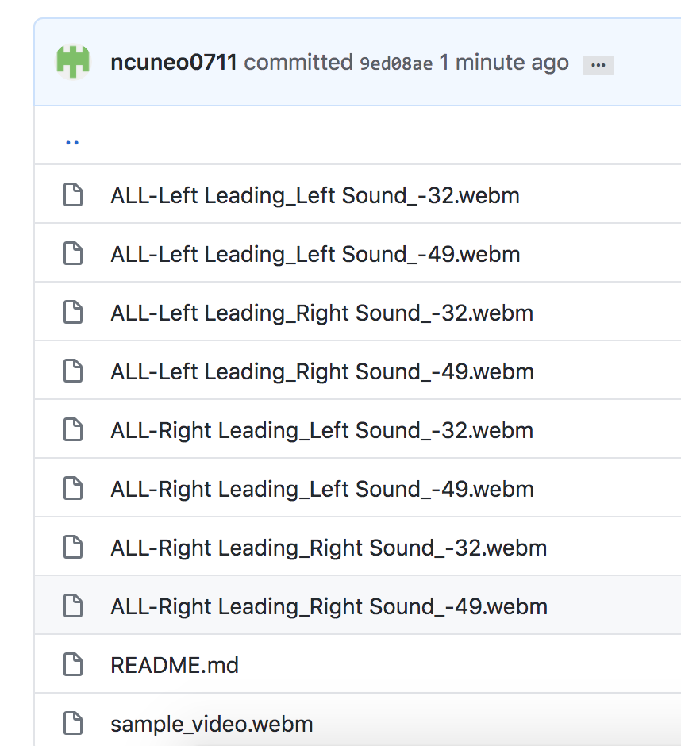
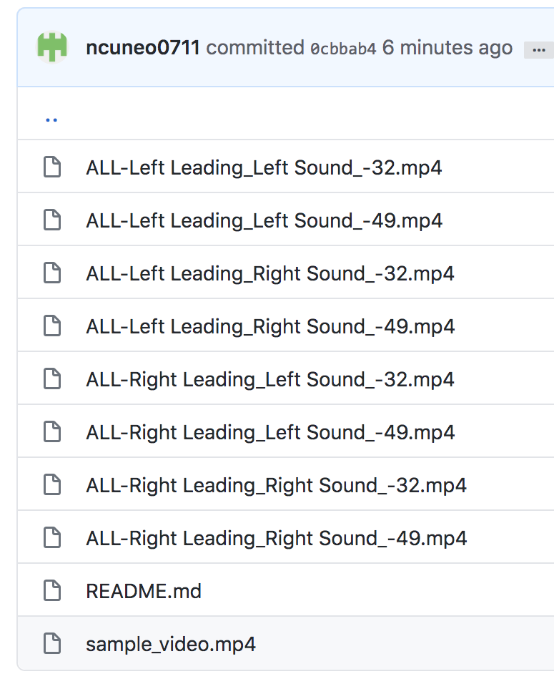
TIP: Name the videos the SAME thing (just with different extensions). This will help your coding immensely

Slide 8
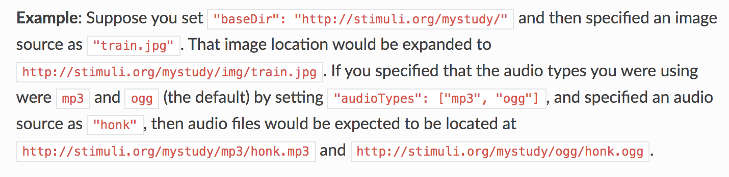
TIP: Name the videos the SAME thing (just with different extensions). This will help your coding immensely
https://lookit.readthedocs.io/en/develop/researchers-prep-stimuli.html

Slide 9
TIP: Name the videos much shorter names than I did!!! (Very annoying to put into the code!)

Slide 10
Stimuli → Lookit Study
Create your stimuli. Export as: mp3 or mp4
Convert your stimuli to include: ogg and webm
Create an online storage platform (Using this: Lookit Tutorial)
Upload all of your stimuli to this location
Insert code into your test trials to retrieve this stimuli
Click here for step 5:
https://lookit.readthedocs.io/en/develop/researchers-prep-stimuli.html

